Slide 2
Willaston District Community Plan (2014) identified 2 key points for Hadlow Road Station :
Maintenance and enhancement of the station buildings and immediate environment (owned by CWaC).
Development of the station as a community heritage resource.
FHRS inaugural AGM March 2015 with an agreed Constitution, Officers and short, medium and long term development plans.

Slide 3
FHRS Annual Santa’s Grotto since 2016 :
Much appreciated support from the following towards our Community Festivities:
FHRS Volunteers
Santas: John Woodrow & Mike Bladon
Elves: Willaston Ranger Guides & students from Ellesmere Port C of E College
Musical Entertainment:
Simon-le-Barber
Hadlow Green Singers
Riversign Choir
Balloon Man: Mike Boyle
Miniature Steam Traction Train Rides: Bill Hatton
Face Painter: Lillian Chapman
St John’s Ambulance

Slide 4
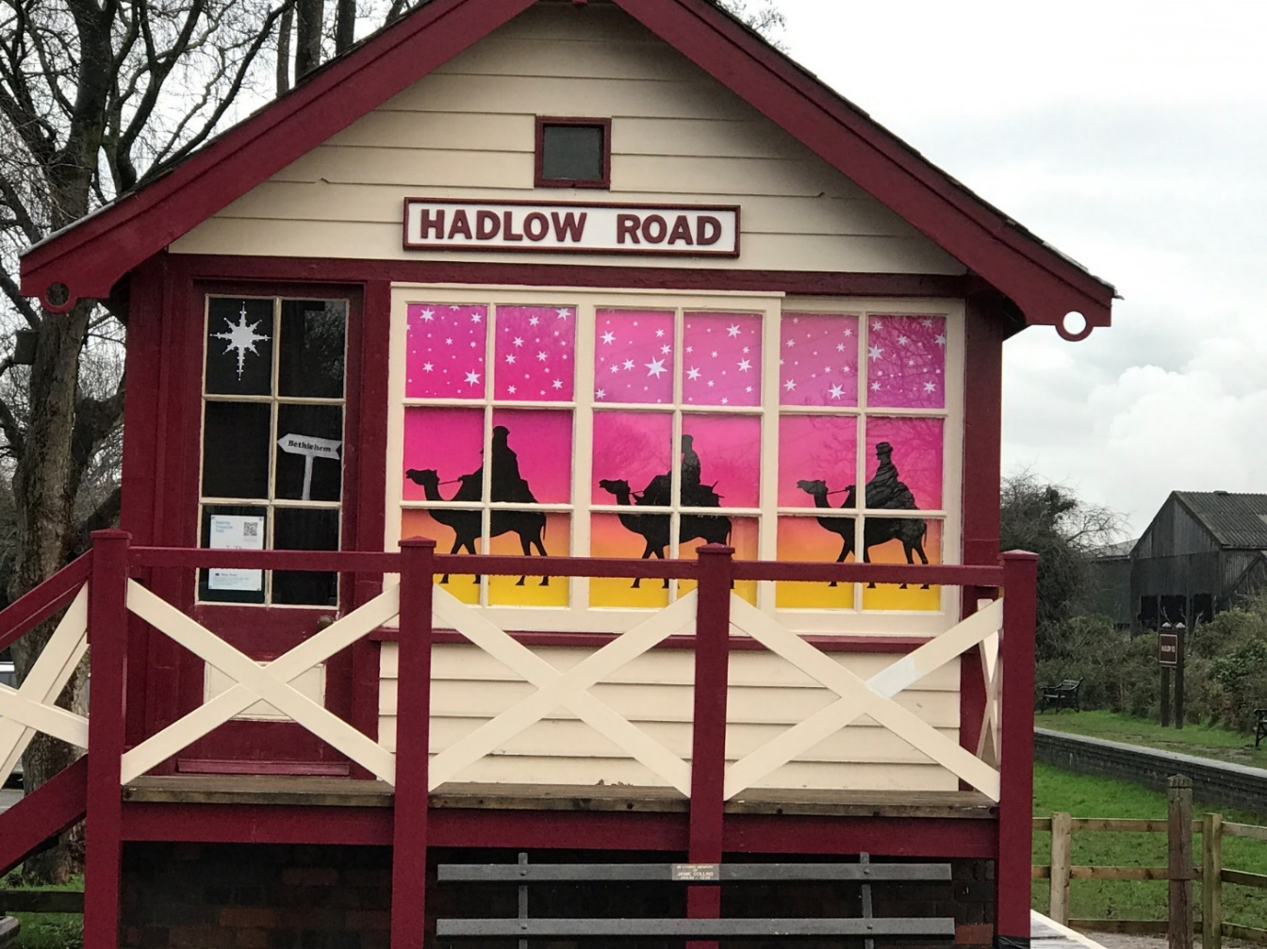
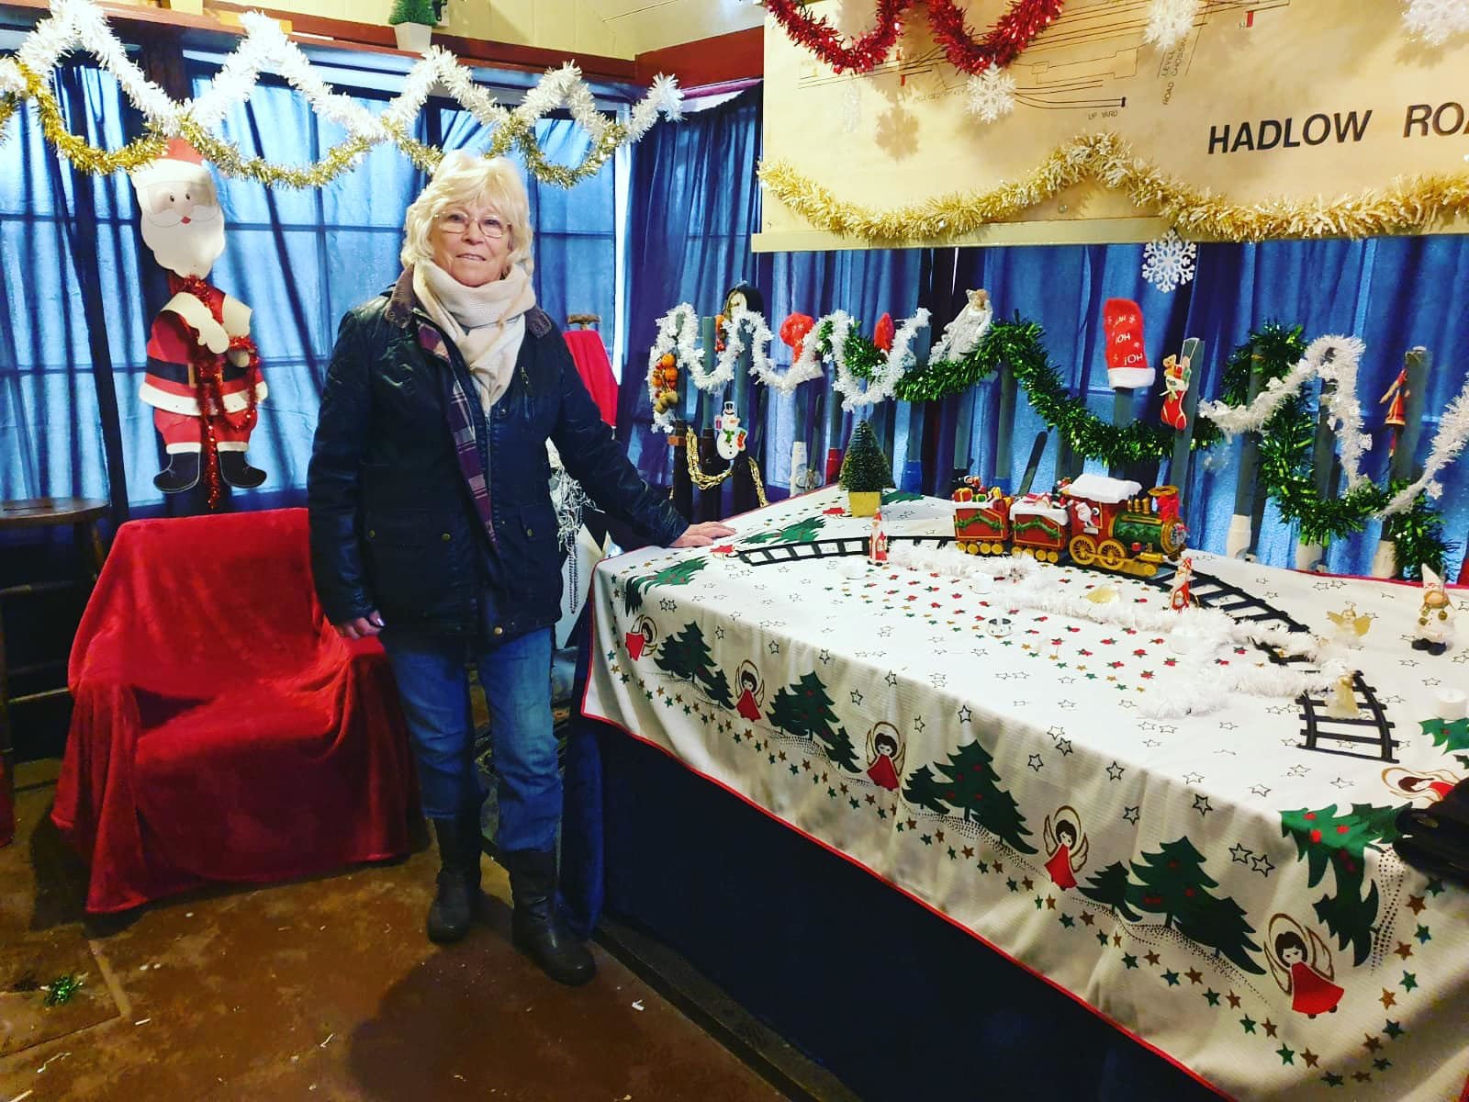
Santa’s Grotto
In the signal box (1)

Slide 5
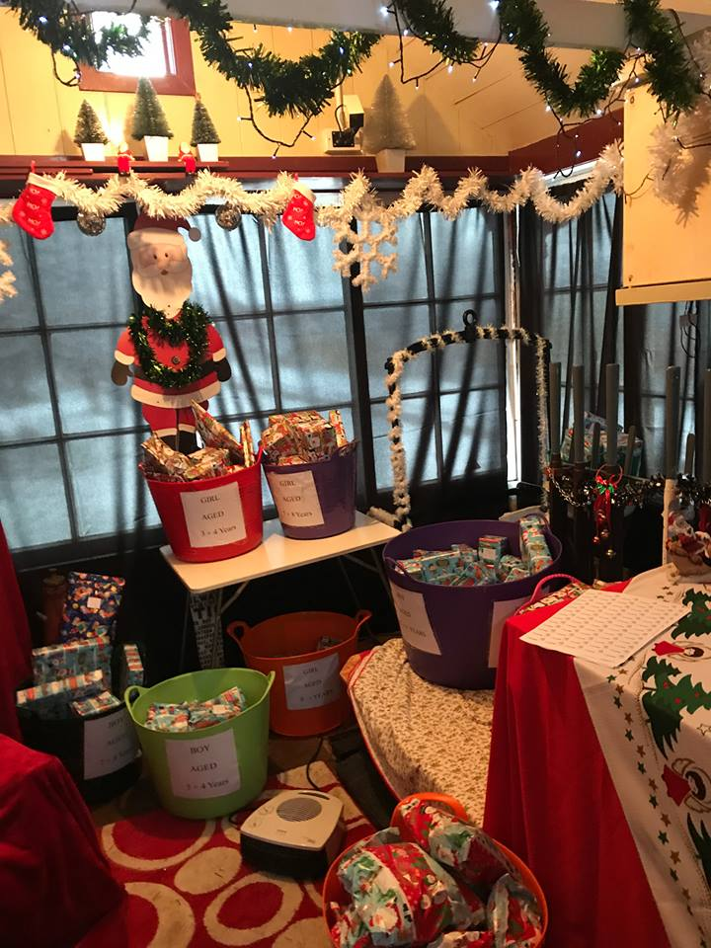
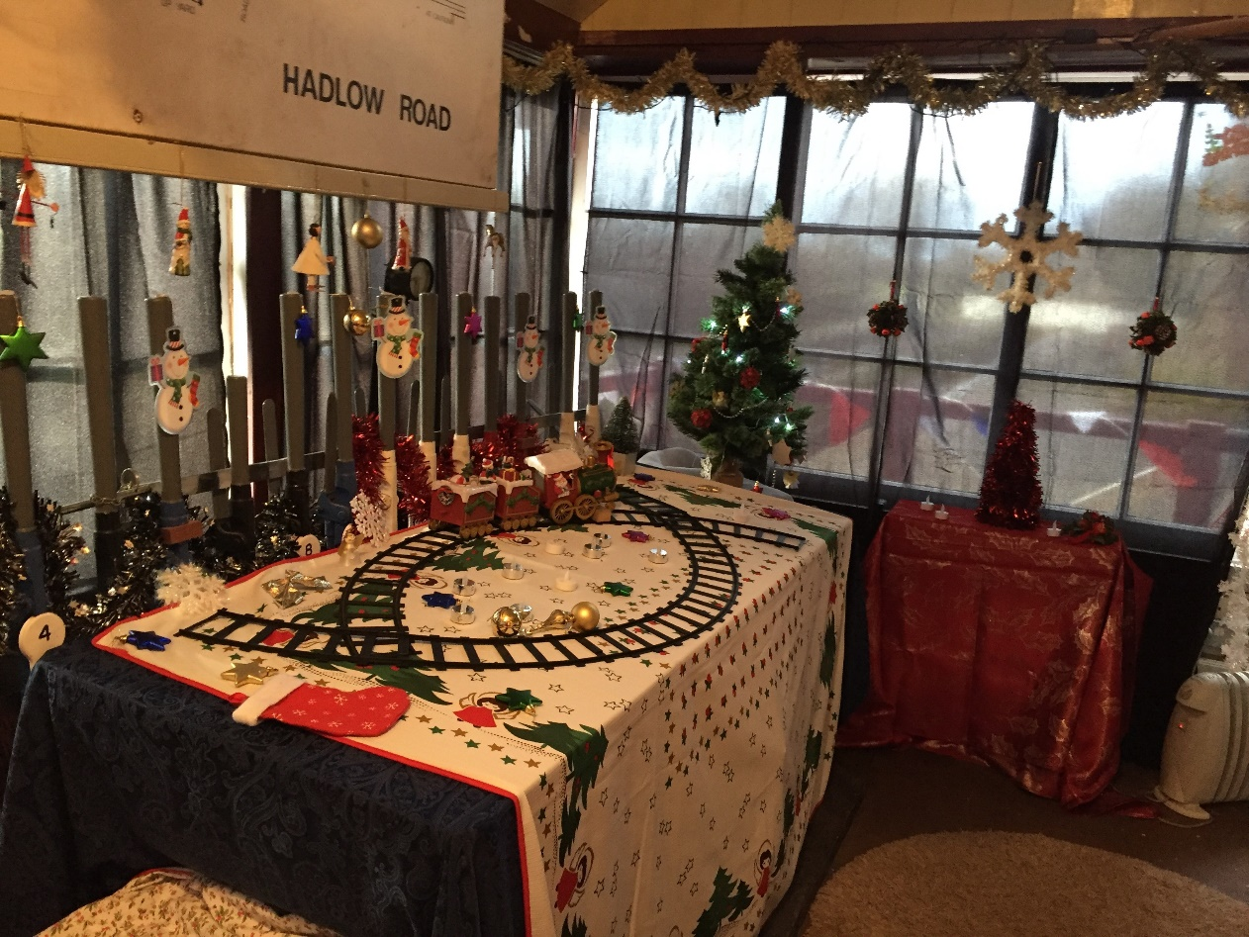
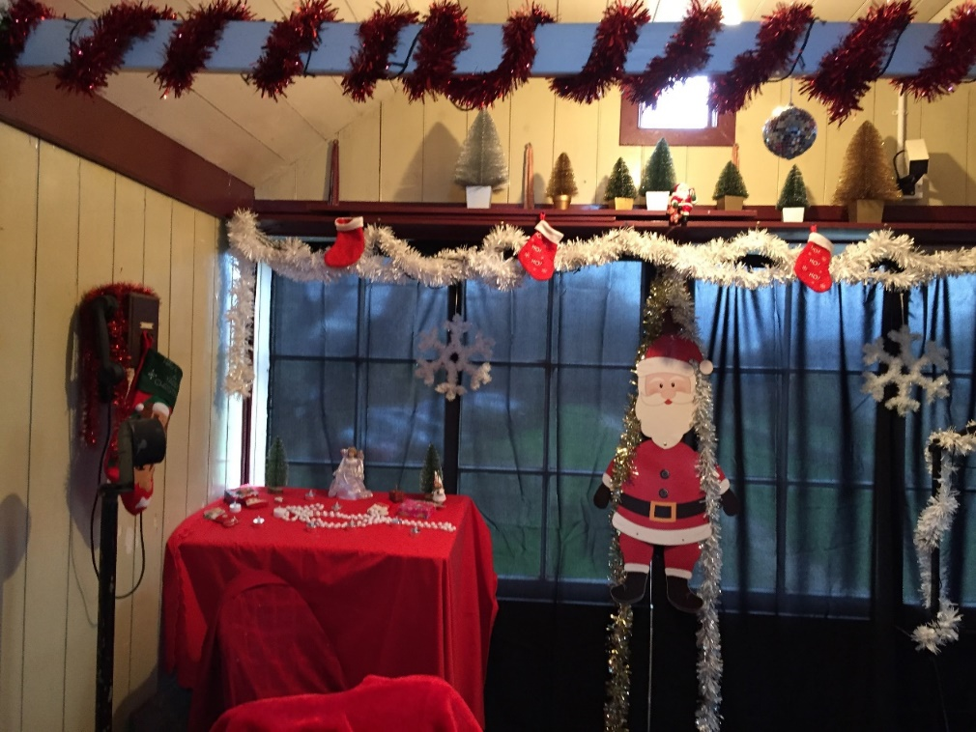
Santa’s Grotto in the signal box (2)
Dec 2016 and annually since.

Slide 6
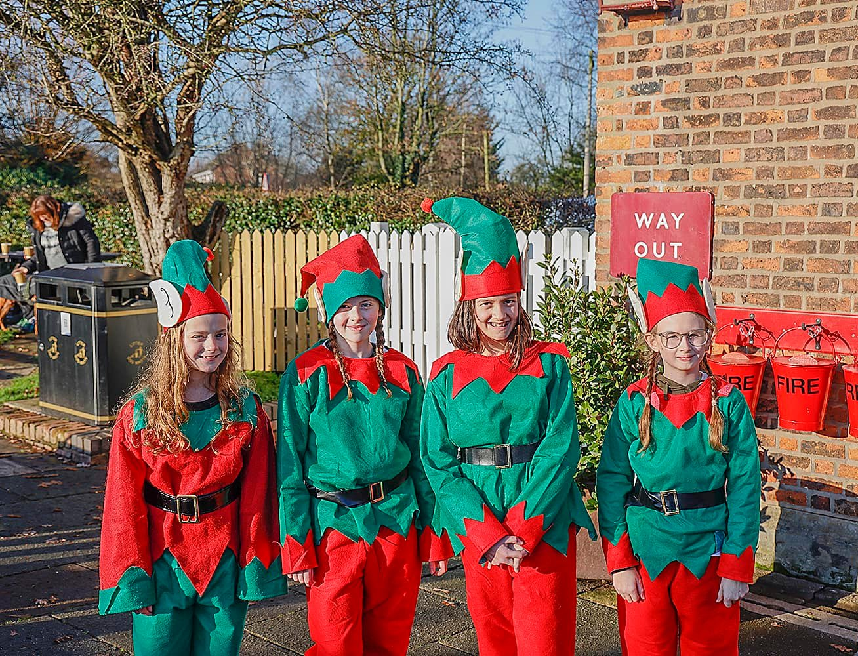
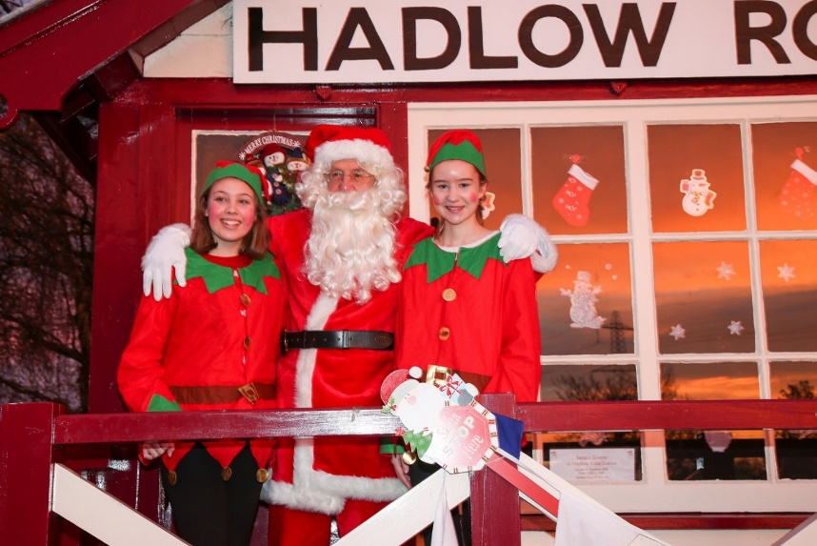
Santa and his Elves

Slide 7
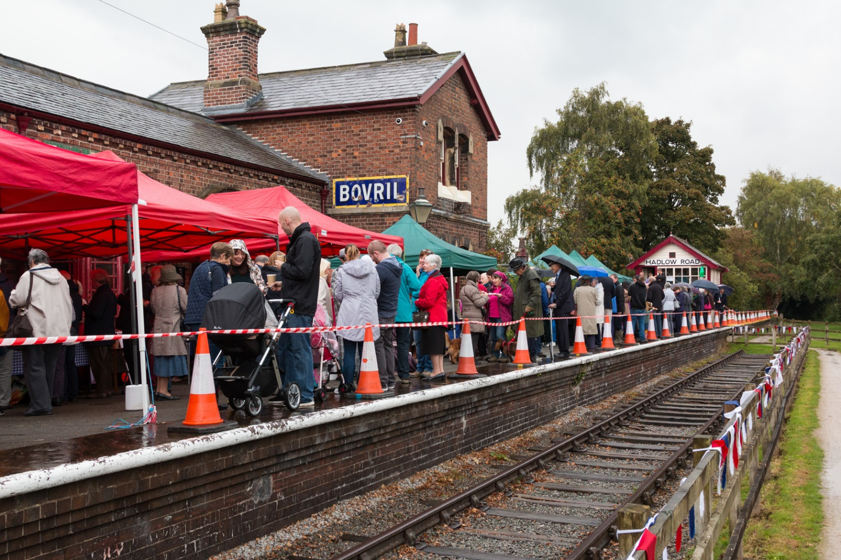
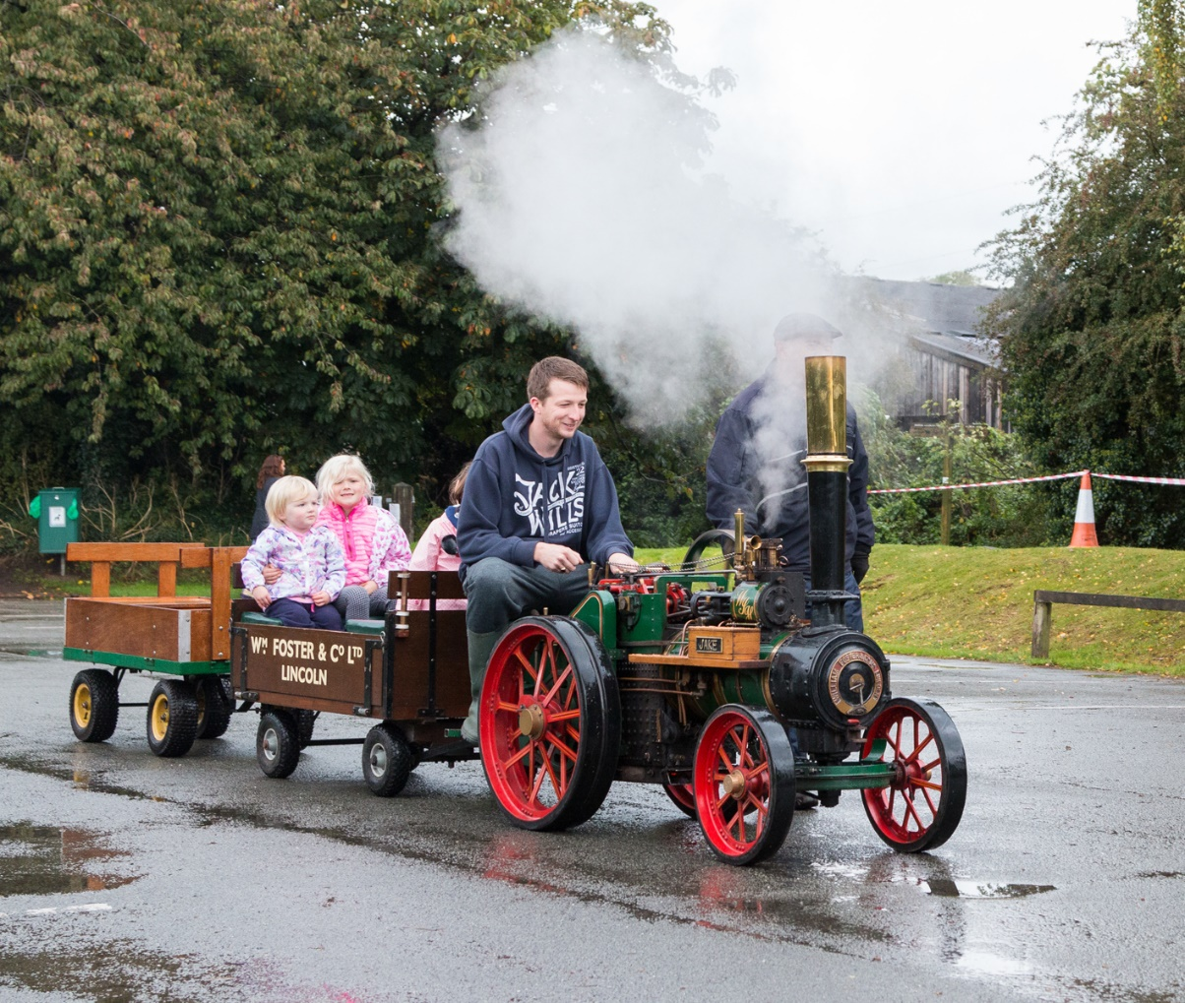
2016 Santa’s Grotto

Slide 8
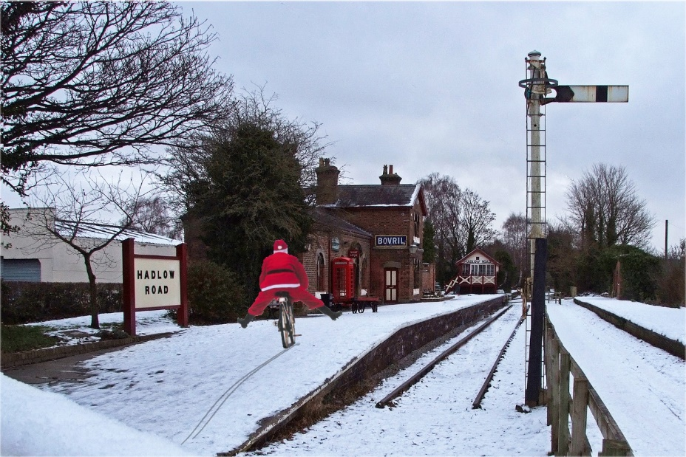
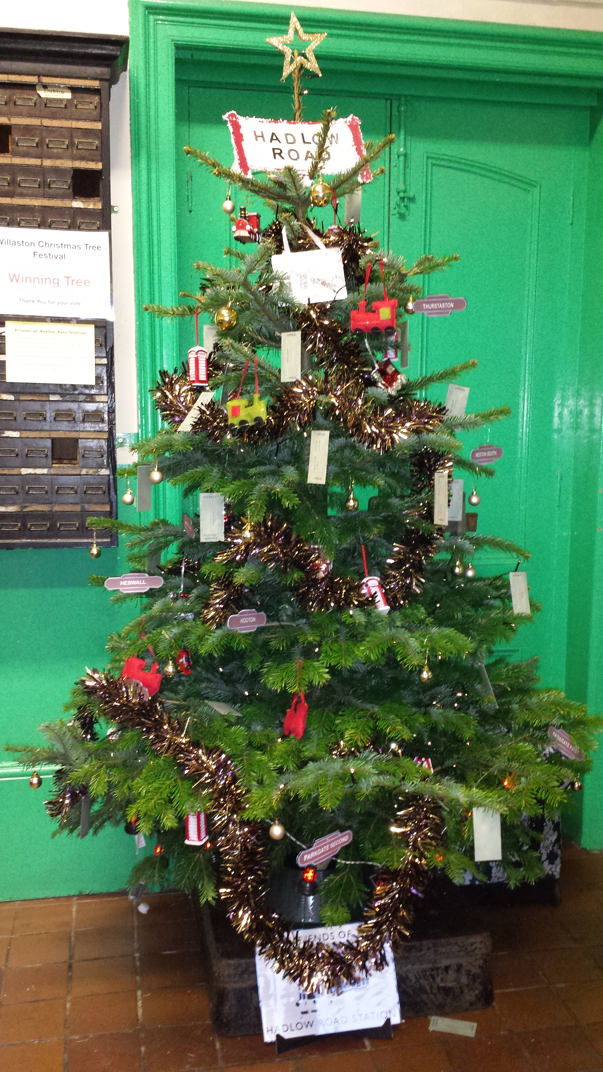
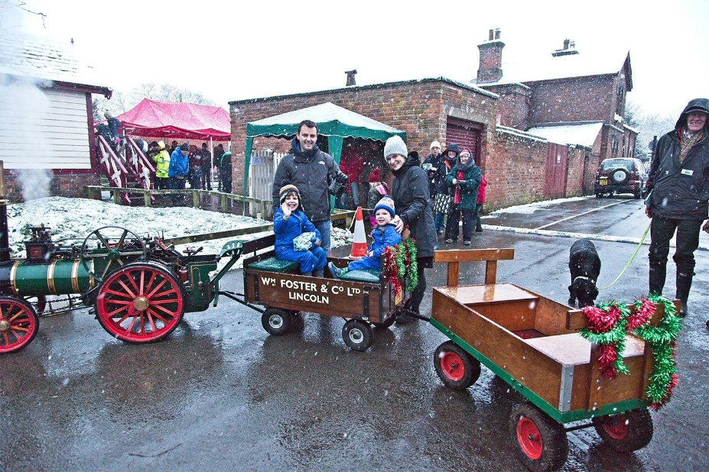
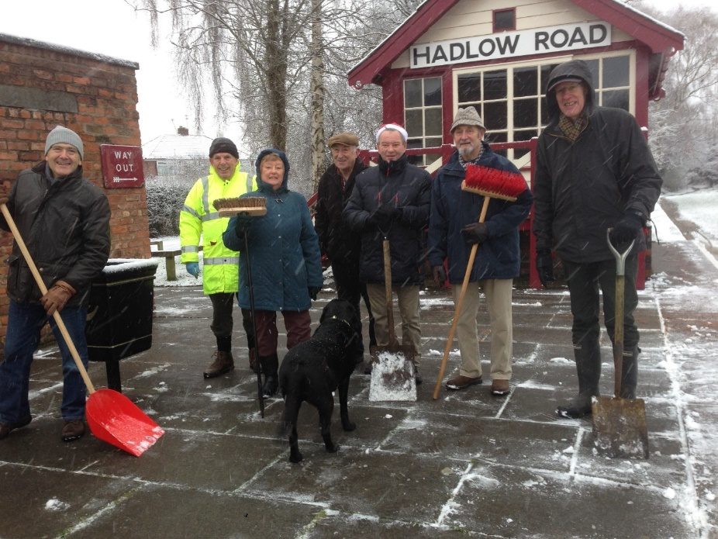
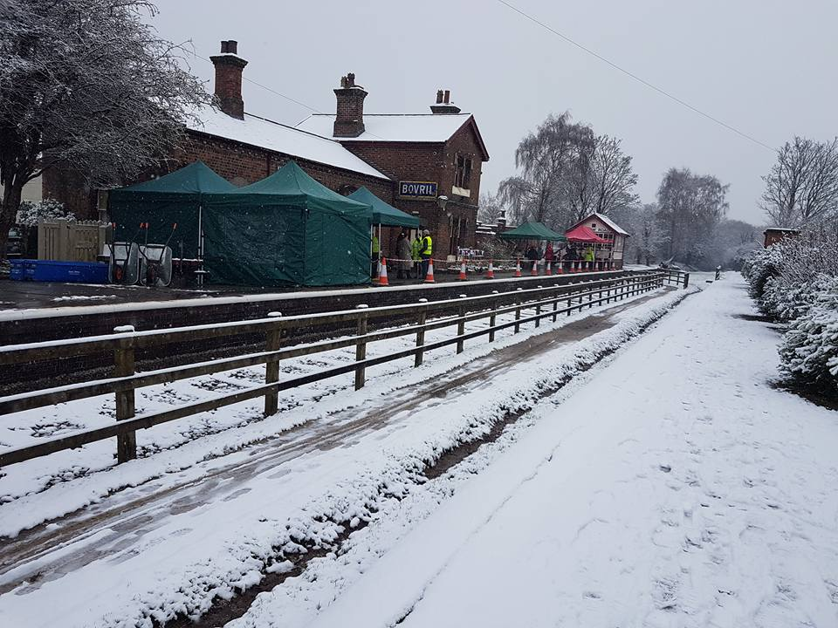
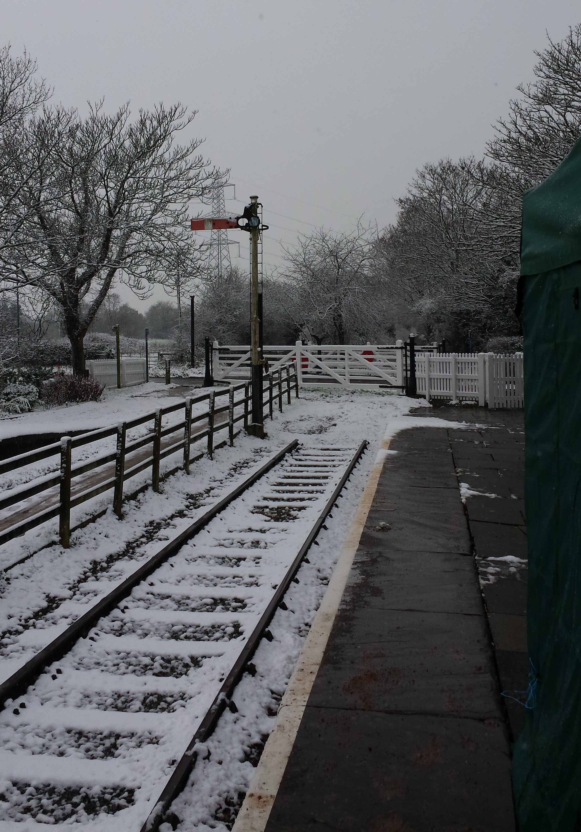
2017 Santa’s Grotto

Slide 9
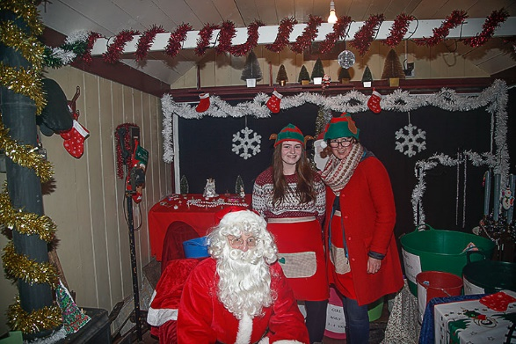
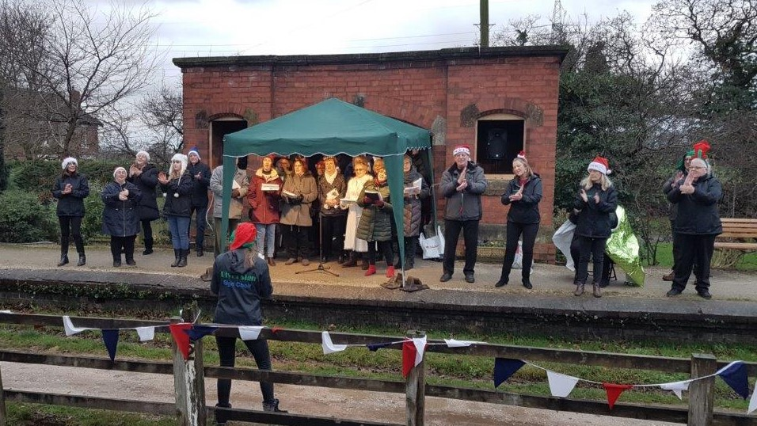
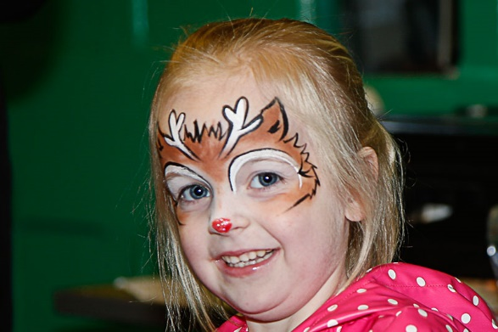
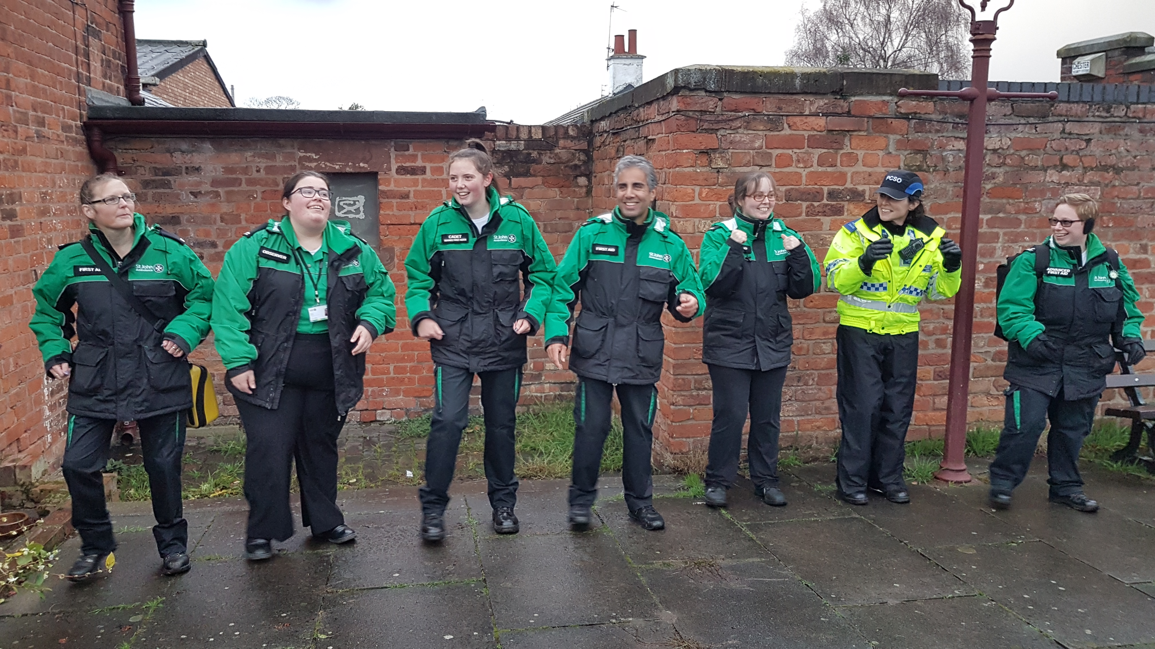
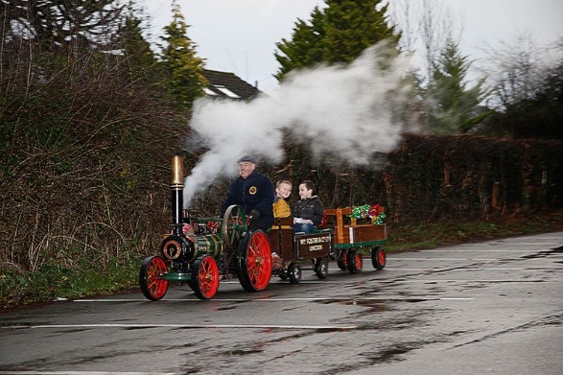
2018 Santa’s Grotto

Slide 10
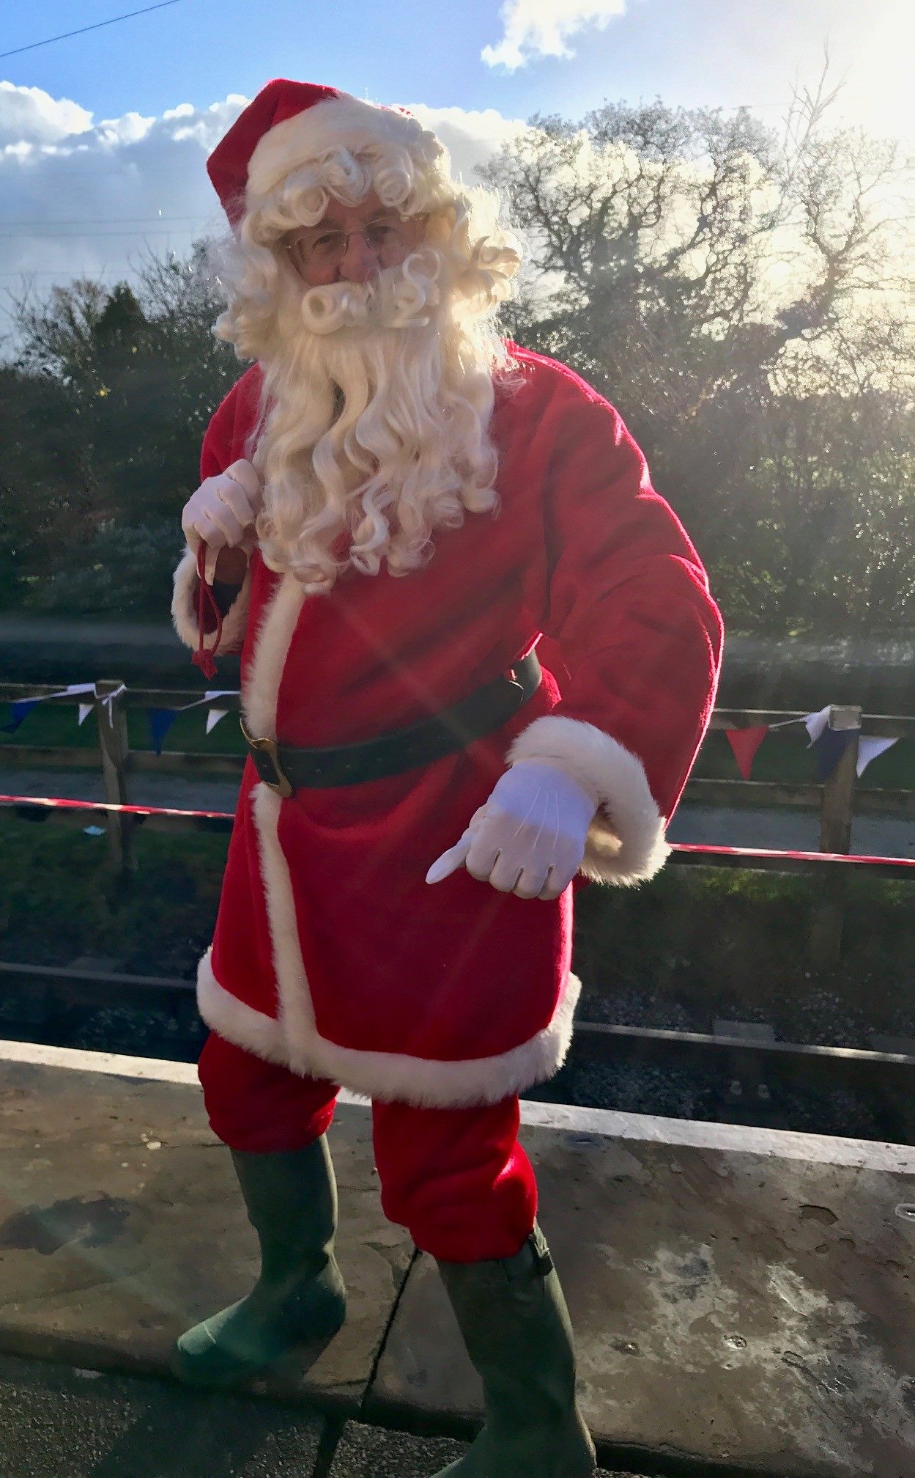
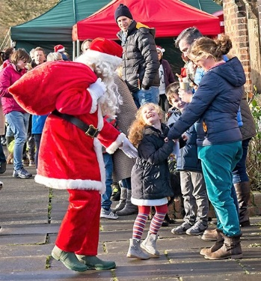
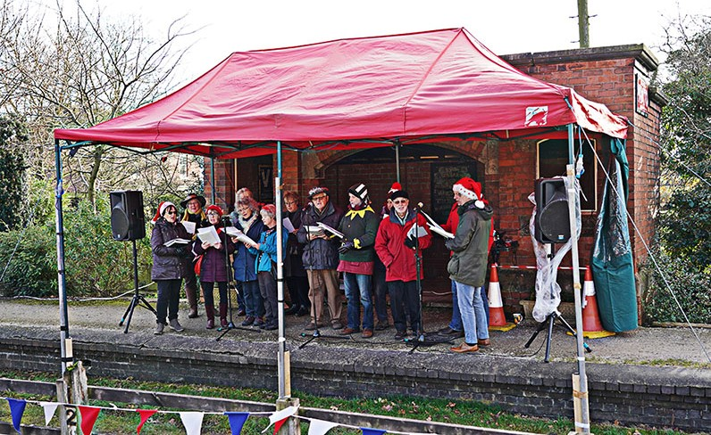
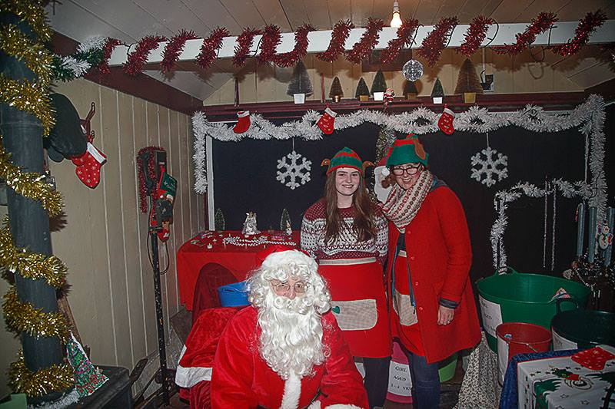
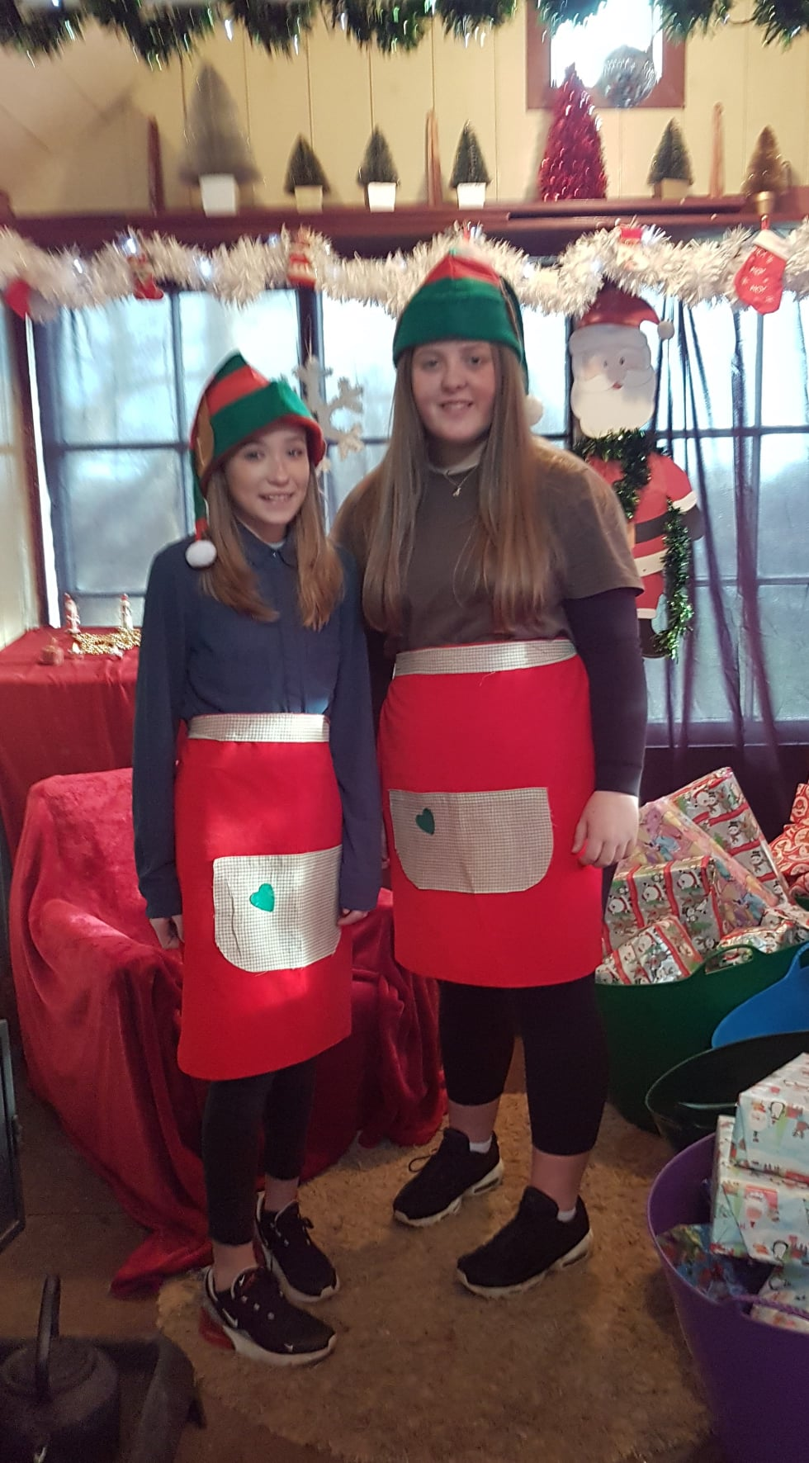
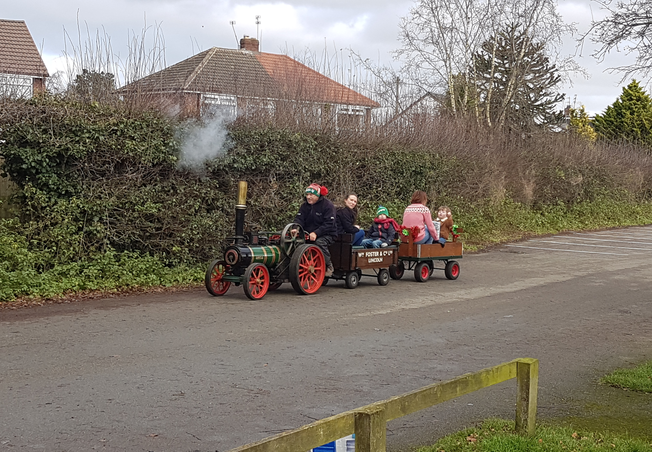
2019 Santa’s Grotto

Slide 11
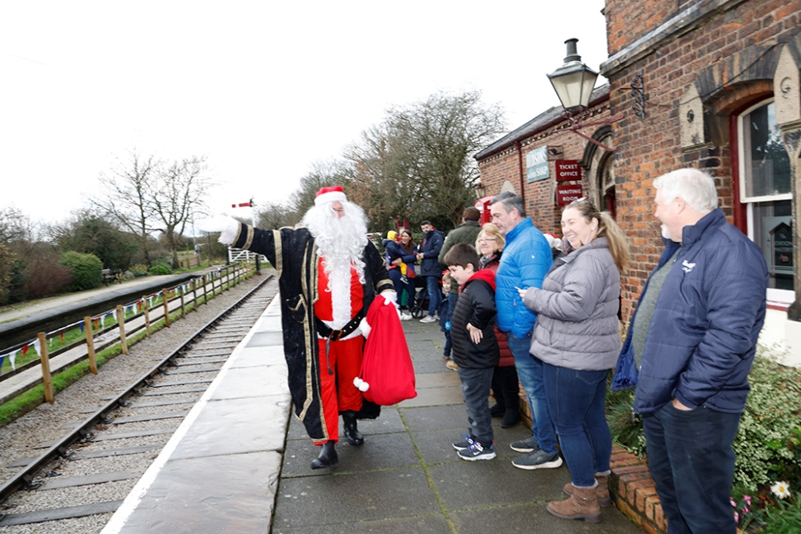
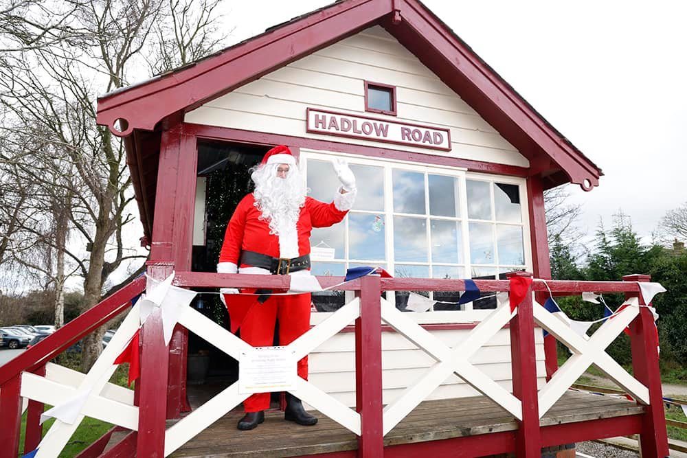
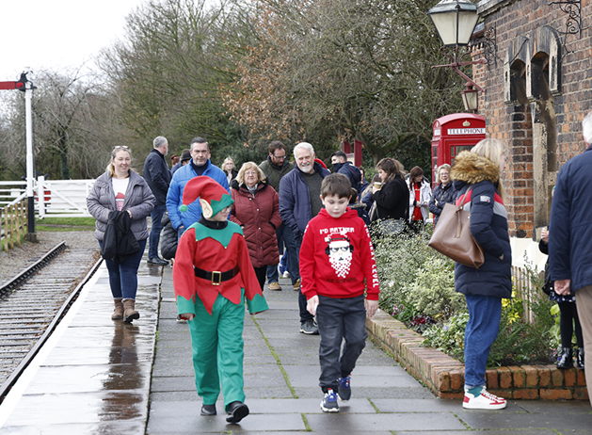
2021 Santa’s Grotto (1)

Slide 12
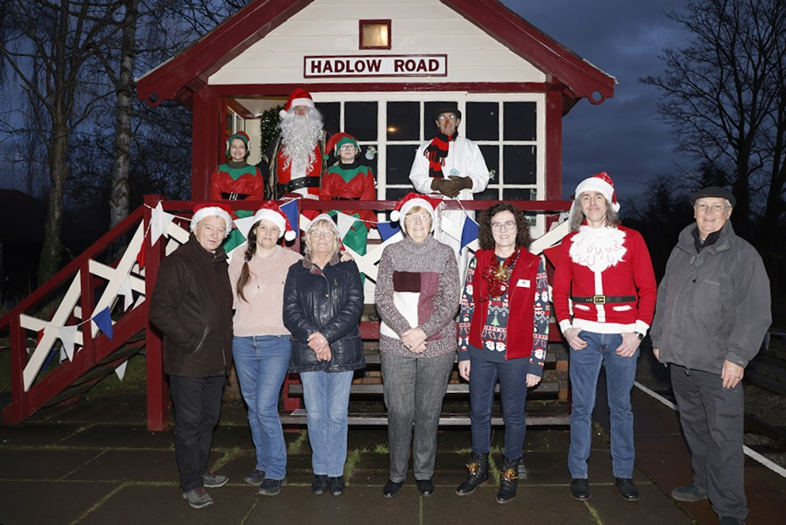
2021 Santa’s Grotto (2)

Slide 13
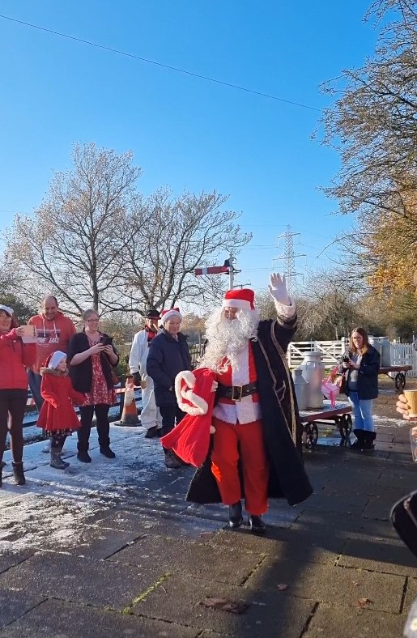
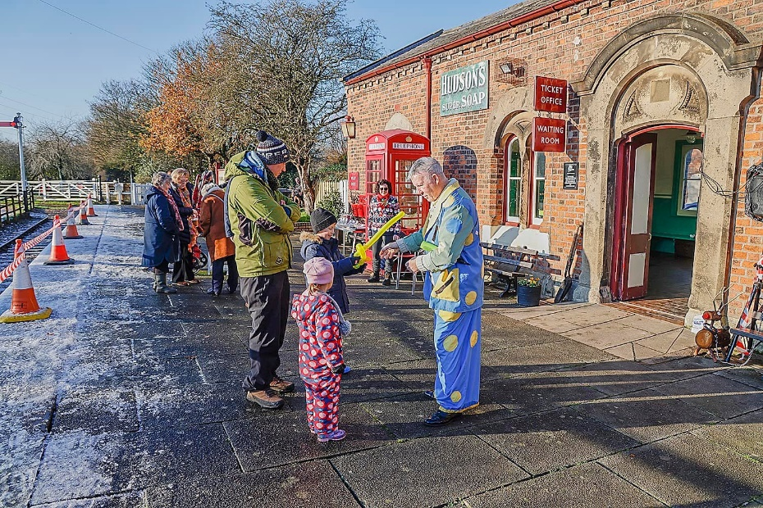
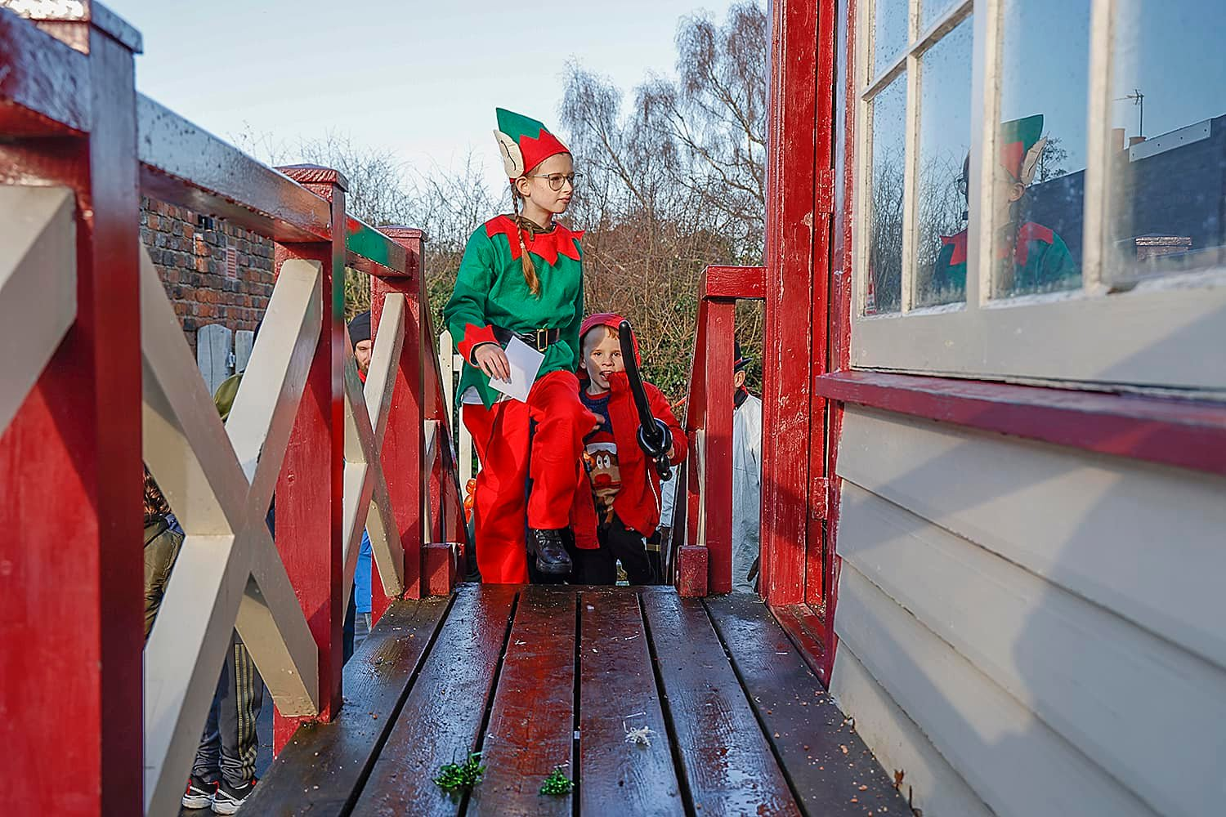
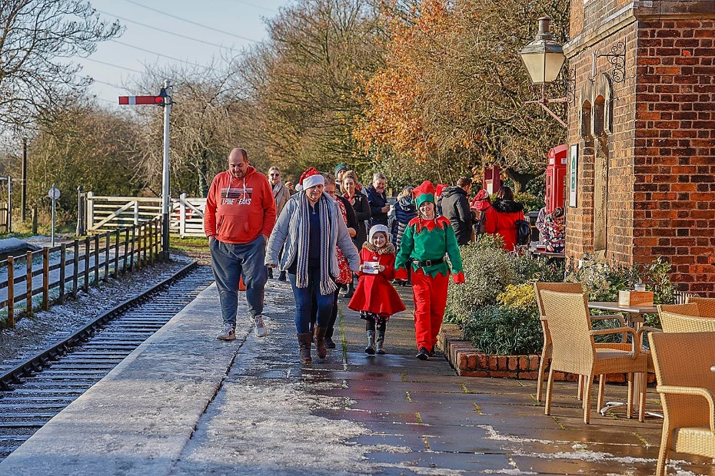
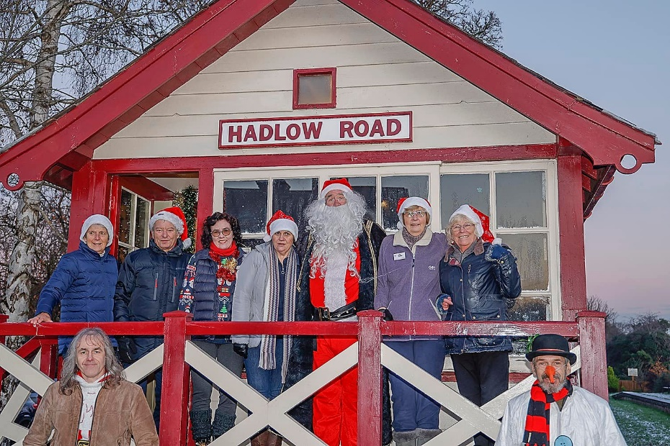
2022 Santa’s Grotto

Slide 14
Further details available at:
https://www.facebook.com/FriendsOfHadlowRoadStation
@friendsofhadlowroadstation
https://willastoninwirralresidents.org/organisations/friends-of-hadlow-road-station

